Slide 1
Student Accommodation
Matcher System (SAM)
Group 10
Notes:
Ask the audience a question about what experiences they have regarding finding accommodation.
How many of you have experienced difficulties when searching for student accommodation?

Slide 2
Difficulty in finding accommodation for students
90%
students live in a city where it is difficult to get an accommodation
Ref: SFS’s report https://www.sfs.se/sites/default/files/br2019_final_0.pdf

Slide 3
Difficulty in finding accommodation for students
6 - 12 months
to get a room and 1 year or more to find an apartment
Ref: SFS’s report https://www.sfs.se/sites/default/files/br2019_final_0.pdf

Slide 4
Problems with existing systems
Long queue time
Payment till the time you are in queue
Notes:
Talk about the existing systems like Boplats, SGS [ You sometimes get an accommodation after you finish the course]
System like Boplats have a system where you have to pay every year to renew your account while you are in the queue.
If you don’t make the payment, you lose queue point.
If you don’t login once every 6 months your account gets deactivated, meaning that you will lose your queue points/position.

Slide 5
The Vision for SAM
Reduce queue time => reduced wait time
No Payment required for the time that you are in the queue
Efficient matching of the student and landlord according to their preferences
All students gets an equal opportunity to get an accommodation
Enables communication between landlord and student
Notes:
Unfair to pay for something without actually being in an accommodation [ imagine 3 or 4 years paying for something just to maintain an account meaninglessly]
Sometimes we get an accommodation far from the University, or would want to stay in a good area or preferred area. So matching to preference matters.
You are only in a queue when you apply for something. So no queue time to be able to apply for something. You can apply for an accommodation even if you register today.
Many students say that they don’t want deep interaction[calls] or in-person interaction with their landlord and vice versa. So based on this we decided we want to enable communication in other ways than a phone call, for example with an automated interaction for fault reporting using tickets.
When landlord is not in town or not using his number, this could be an effective way to communicate issues related to accommodation.

Slide 6
Elicitation Techniques
Brainstorming
Interviews
Hall of Fame
Creativity Triggers
Notes:
Brainstorming :
When brainstorming is usually done. [in the beginning or the end] [We could do it in an early phase because we had a good knowledge about the domain].
When our group did it and for what. [ there was no stage where we did it, we just did it throughout the project]
Interviews :
We interviewed (16) students and (5) landlords [21 interviewees in total]
We did it in the beginning [ gave us more insights on what the problems are in reality]
Helped us improve our assumptions about the requirements
Hall of fame and the creativity triggers :
Found that creativity triggers were simpler
Hall of fame had characters that did not have anything new to add to our system. Because it was hard to imagine why the character would want to use our system. We felt kind of limited to think around the character. Restricted our thinking.
Our system is not the kind that needs innovation or “cool” features.
But for the creativity triggers though, When we saw the words like “Security”, it actually helped us relate the word with our project.

Slide 7
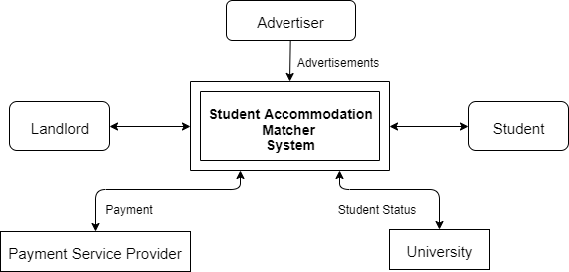
Specification Techniques
Context Diagram
Task Descriptions
Stakeholder Map
Data Models and Data Dictionary
Notes:
Context Diagram :
Talk about advertisers being added later . First we thought that they would interact with the system owners. But then we thought that it would be better for them to interact with them through the system. This would reduce steps in the process [eg: adding a picture for ads]. and limit it to one single platform [eg: not making use of E-mail]
We thought of Ladok but we decided to go on a more high level. When we said University , that would give a good overview and not get into details of how the university will provide that information [through ladok or University admissions]
Task description :
We were unsure about the level of detail that we need to discuss on the task description. We felt that they should be more complete.
Stakeholder map :
We have divided the stakeholders as per their influence and impact on the system. The placement of the stakeholders was a challenge as when we discussed, they could be in multiple quadrants. This is what all of us decided as the final stakeholder map.
Data Models and Data Dictionary :
We were unsure about the level of technical detail that we are supposed to explain. So, we struggled between creating them as database tables vs general description of data fields.

Slide 8
Specification Techniques
Context Diagram
Task Descriptions
Stakeholder Map
Data Models and Data Dictionary
Notes:
Context Diagram :
Talk about advertisers being added later . First we thought that they would interact with the system owners. But then we thought that it would be better for them to interact with them through the system. This would reduce steps in the process [eg: adding a picture for ads]. and limit it to one single platform [eg: not making use of E-mail]
We thought of Ladok but we decided to go on a more high level. When we said University , that would give a good overview and not get into details of how the university will provide that information [through ladok or University admissions]
Task description :
We were unsure about the level of detail that we need to discuss on the task description. We felt that they should be more complete. egs?
Stakeholder map :
We have divided the stakeholders as per their influence and impact on the system. The placement of the stakeholders was a challenge as when we discussed, they could be in multiple quadrants. This is what all of us decided as the final stakeholder map.
Data Models and Data Dictionary :
We were unsure about the level of technical detail that we are supposed to explain. So, we struggled between creating them as database tables vs general description of data fields.

Slide 9
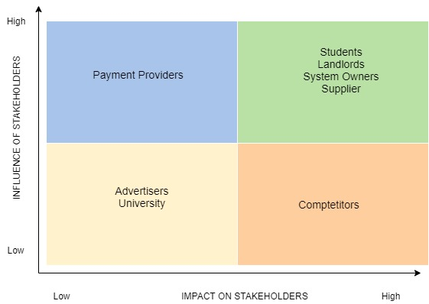
Specification Techniques
Context Diagram
Task Descriptions
Stakeholder Map
Data Models and Data Dictionary
Notes:
Context Diagram :
Talk about advertisers being added later . First we thought that they would interact with the system owners. But then we thought that it would be better for them to interact with them through the system. This would reduce steps in the process [eg: adding a picture for ads]. and limit it to one single platform [eg: not making use of E-mail]
We thought of Ladok but we decided to go on a more high level. When we said University , that would give a good overview and not get into details of how the university will provide that information [through ladok or University admissions]
Task description :
We were unsure about the level of detail that we need to discuss on the task description. We felt that they should be more complete.
Stakeholder map :
We have divided the stakeholders as per their influence and impact on the system. The placement of the stakeholders was a challenge as when we discussed, they could be in multiple quadrants. This is what all of us decided as the final stakeholder map.
Data Models and Data Dictionary :
We were unsure about the level of technical detail that we are supposed to explain. So, we struggled between creating them as database tables vs general description of data fields.

Slide 10
Specification Techniques
Context Diagram
Task Descriptions
Stakeholder Map
Data Models and Data Dictionary
Notes:
Context Diagram :
Talk about advertisers being added later . First we thought that they would interact with the system owners. But then we thought that it would be better for them to interact with them through the system. This would reduce steps in the process [eg: adding a picture for ads]. and limit it to one single platform [eg: not making use of E-mail]
We thought of Ladok but we decided to go on a more high level. When we said University , that would give a good overview and not get into details of how the university will provide that information [through ladok or University admissions]
Task description :
We were unsure about the level of detail that we need to discuss on the task description. We felt that they should be more complete.
Stakeholder map :
We have divided the stakeholders as per their influence and impact on the system. The placement of the stakeholders was a challenge as when we discussed, they could be in multiple quadrants. This is what all of us decided as the final stakeholder map.
Data Models and Data Dictionary :
We were unsure about the level of technical detail that we are supposed to explain. So, we struggled between creating them as database tables vs general description of data fields.

Slide 11
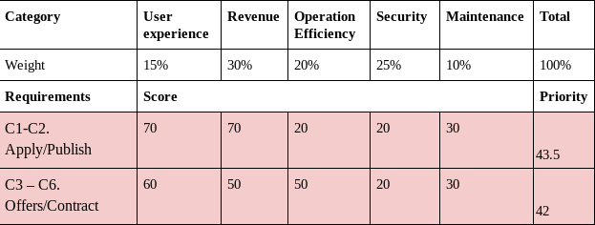
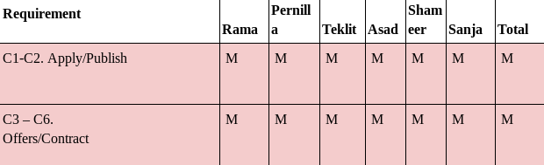
Prioritization Techniques
MoSCoW
Priority Scorecard
Notes:
Difficulties to decide on what method to use, what suits us best
Challenge was to decide what has the highest priority from different points of view as different stakeholders.
Priority Scorecard was more challenging since it gives us deeper understanding of feature priority itself.
We discussed about what criteria have biggest impact on our system, and next challenge was to decide on weight on each category.
Prioritization was redone in Release 2.

Slide 12
To conclude...
Working in a group is challenging
Knowledge about various techniques and tools
Why to use requirement specification document
How to use requirement specification document
What to focus on from different perspectives
Thank you for your attention!
Notes:
Working in a group, generally, is always a challenge, and with 6 people of different backgrounds and cultures, the challenge was upped a notch.
However, as weeks passed on and we got to learn about each other more and befriend, the challenge started to subdue.
In terms, of the course itself, we learnt several techniques and tools to elicit, specify, prioritize requirements.
These techniques, which we intend to use in our future endeavors, would help us be more productive engineers.
It has been a nice experience in overall. Requirements Engineering course helped us understand the importance of fine-tuning requirements.

Slide 13
Student Accommodation
Matcher System (SAM)
Group 10
Notes:
Ask the audience a question about what experiences they have regarding finding accommodation.
How many of you have experienced difficulties when searching for student accommodation?

